Slide 1
Employee Attendance Management System
SEP 769:Cyber Physical Systems
Darshan Parbadiya

Slide 2
Introduction
In today's fast-paced corporate environment, efficient management of employee attendance stands as a cornerstone for maintaining productivity and accurate administrative records.
Traditional methods of attendance tracking, relying heavily on manual input or outdated electronic systems, are proving increasingly inadequate. These methods are not only time-consuming but also prone to errors and manipulation.
Recognizing the need for a modern solution, our project introduces an innovative Employee Attendance Management System (EAMS) that leverages cutting-edge Internet of Things (IoT) technology.
Through the integration of IoT technologies and sophisticated software solutions, our system aims to streamline the attendance tracking process, offering a more reliable, efficient, and user-friendly alternative to conventional methods.
By harnessing the power of Raspberry Pi technology, coupled with advanced components such as the Camera Module, Buzzer, and Speaker, our solution provides a comprehensive and automated approach to recording employee attendance.
This presentation will delve into the intricacies of our automated attendance system, exploring its architecture, functionalities, and the transformative potential it holds for revolutionizing traditional attendance management practices.

Slide 3
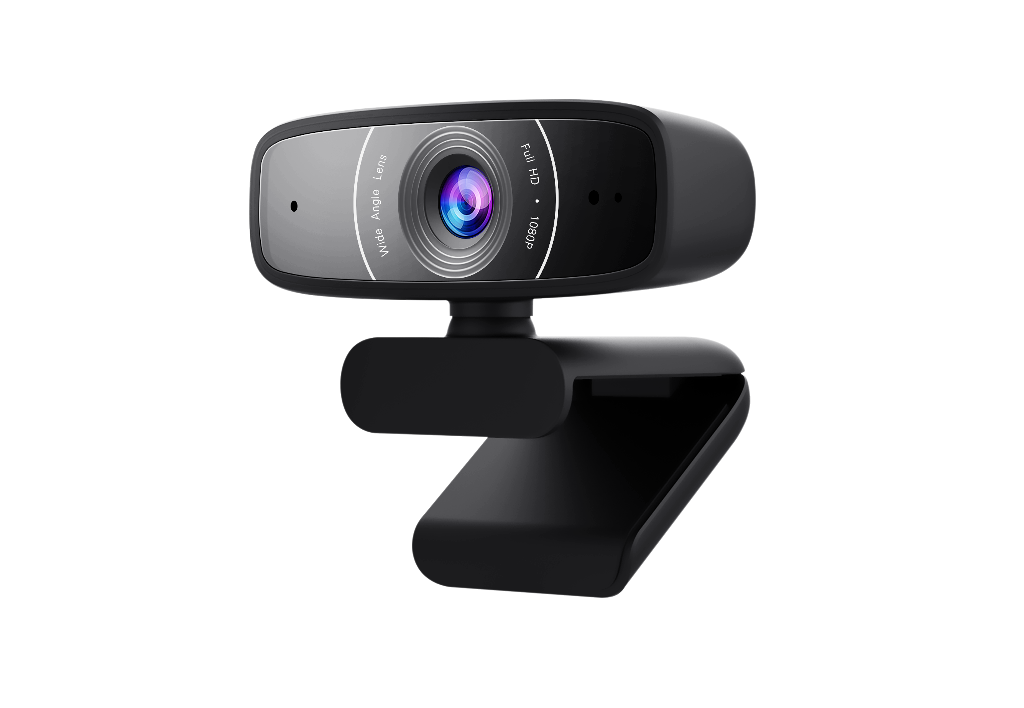
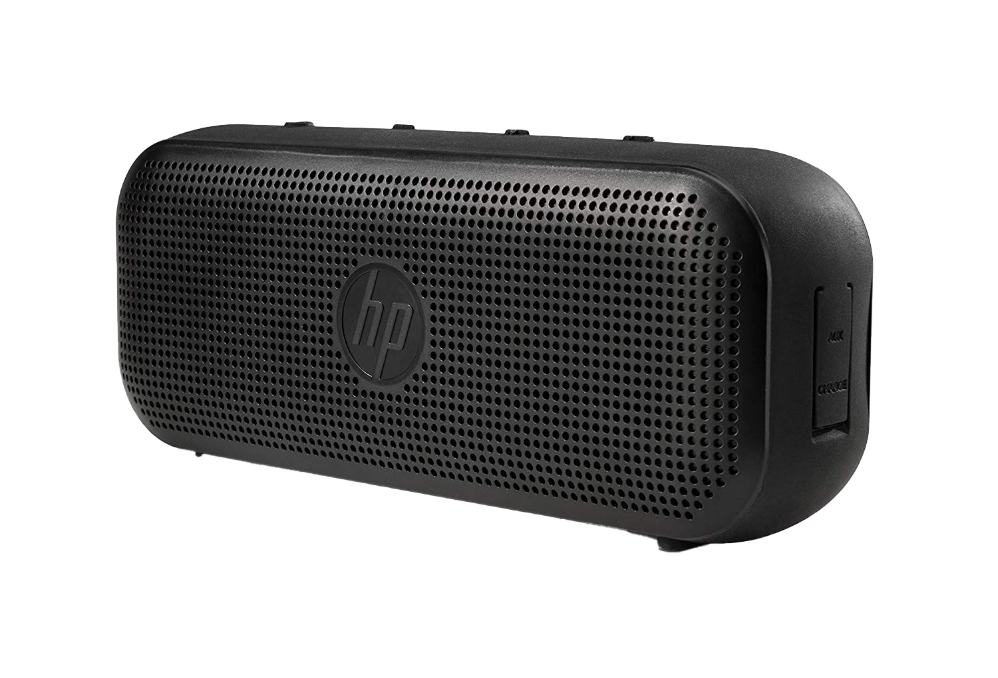
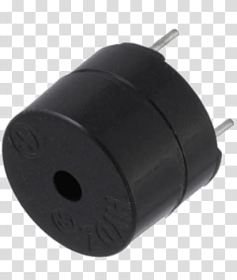
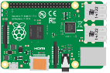
Components Used
Raspberry Pi: Controls the system and manages interactions.
Camera Module: Captures employee images for attendance verification.
Buzzer: Provides audible feedback for successful attendance recording.
Speaker: Gives real-time feedback for a better user experience.

Slide 4
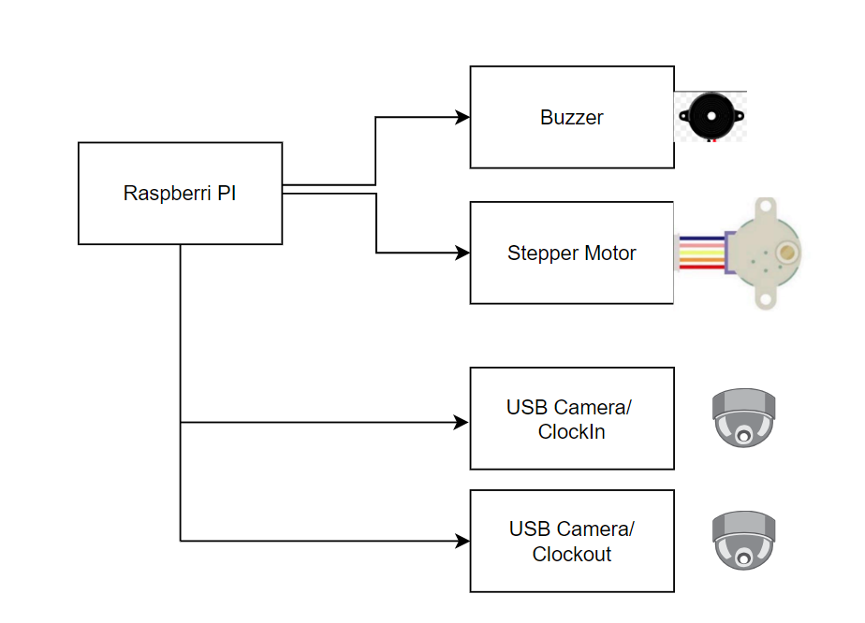
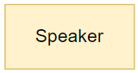
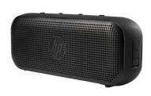
Block Diagram

Slide 5
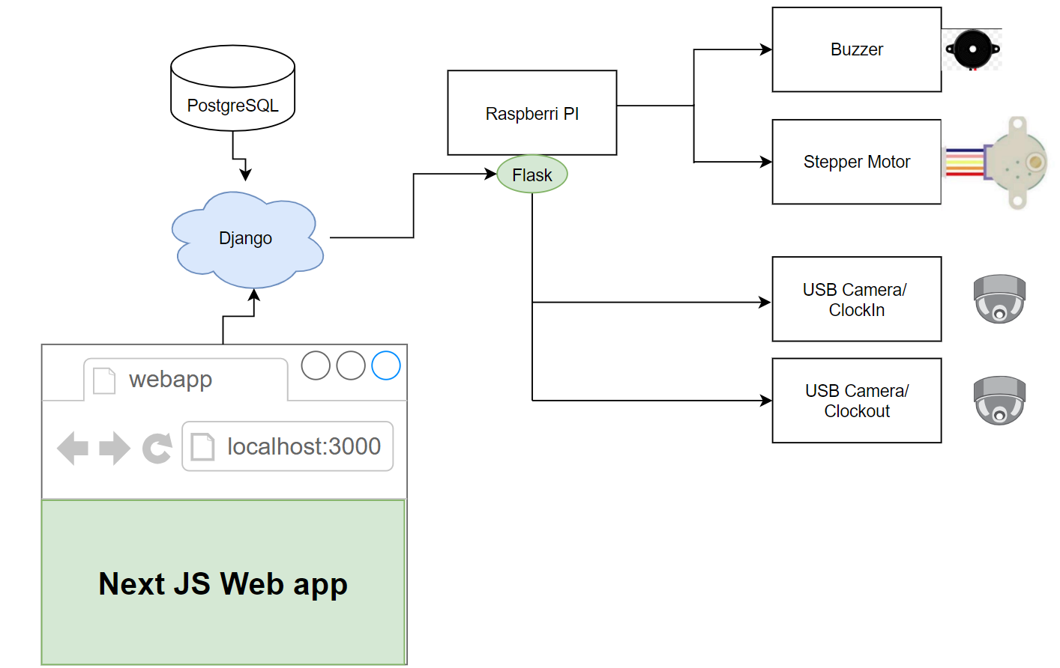
Block Diagram of the entire system.

Slide 6
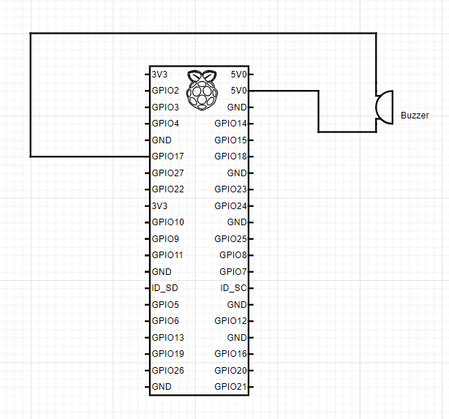
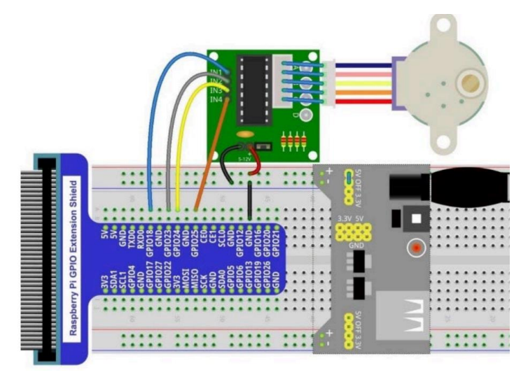
Circuit Diagram

Slide 7
Employee Management Process
Image Capture
Raspberry Pi takes photos of employees using the Camera Module and using flask app it send the video to Django backend.
Image Processing
Backend algorithms in Django check these images for attendance verification and send data to flask backend database to confirm employee presence.
Facial Recognition
Deep learning algorithms recognize employee faces for accurate identification.
Attendance Recording
Feedback
Verified attendance data, including check-in and check-out times, is securely stored in the system's database.
Buzzer and speaker provide instant feedback to users regarding attendance status.
Dataset Management
Users can be added to the dataset for recognition. If an unknown person is detected, their photo is captured, and their photo and other details like date and time is captured into the database table.
Work Time and Routine Monitoring:
Utilizing Next.js, employees can view their work hours and daily routines on the website.

Slide 8
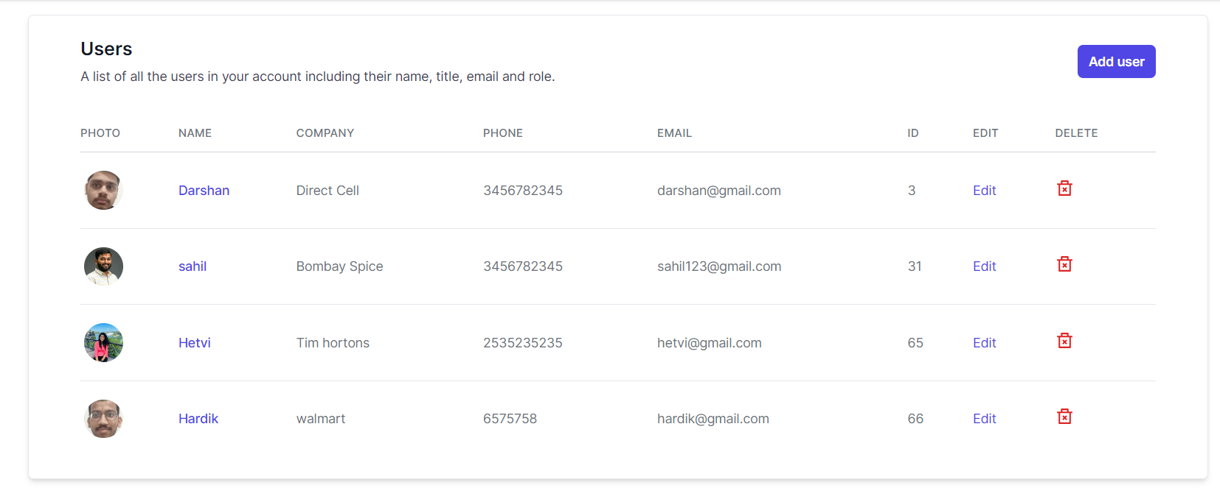
Features of the web app
User creation and user management.

Slide 9
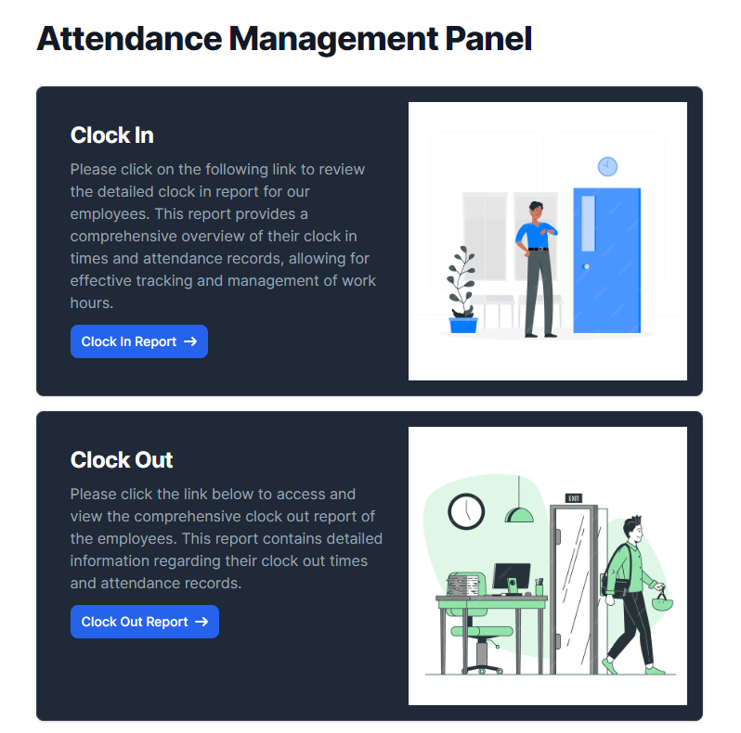
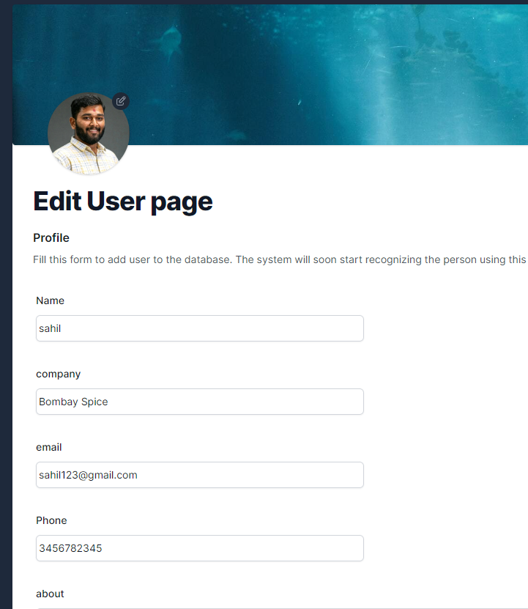

Features of the web app

Slide 10
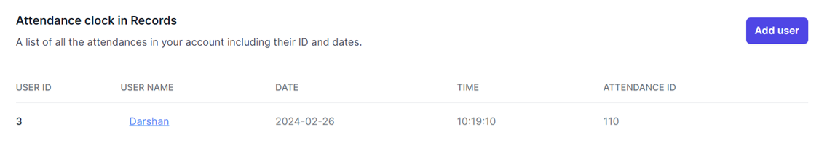
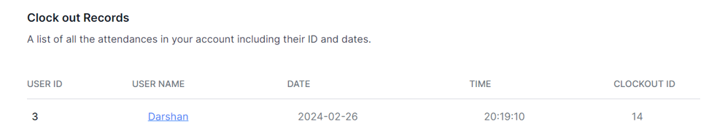
Clock In and clock out Records

Slide 11
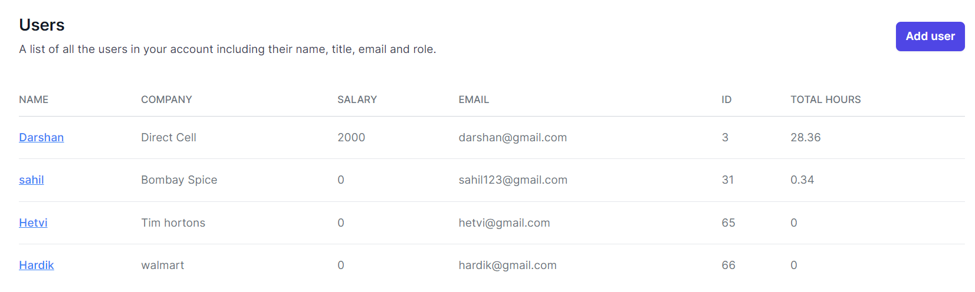
Hours Calculation

Slide 12
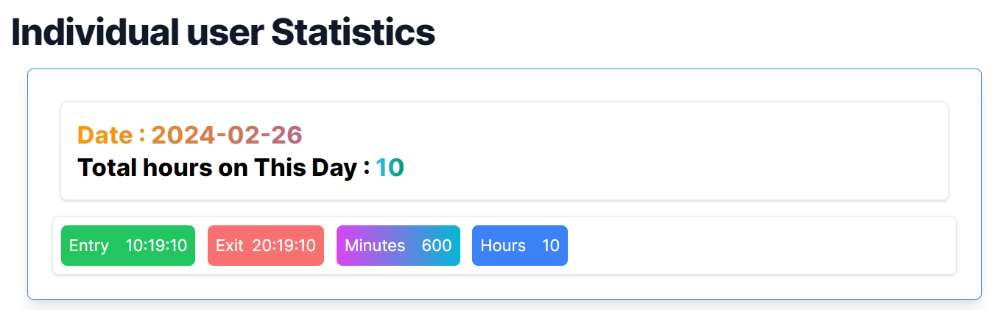
Individual user hours report

Slide 13
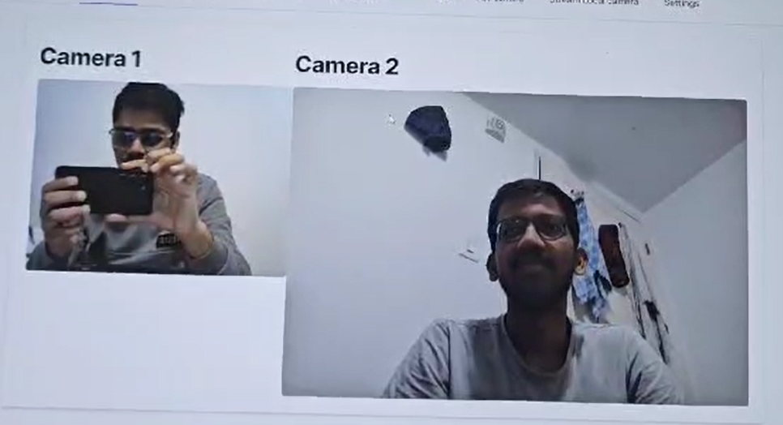
Live streaming of USB Cameras

Slide 14
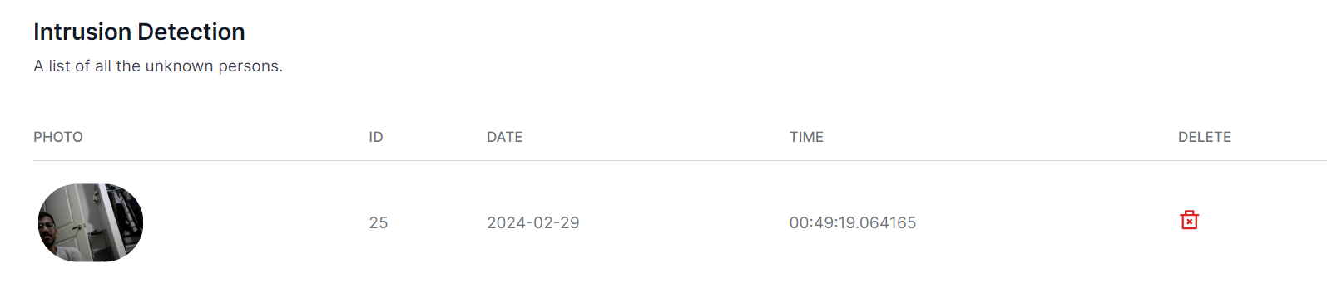
Security
If unknown person is detected then image of that person will be stored.

Slide 15
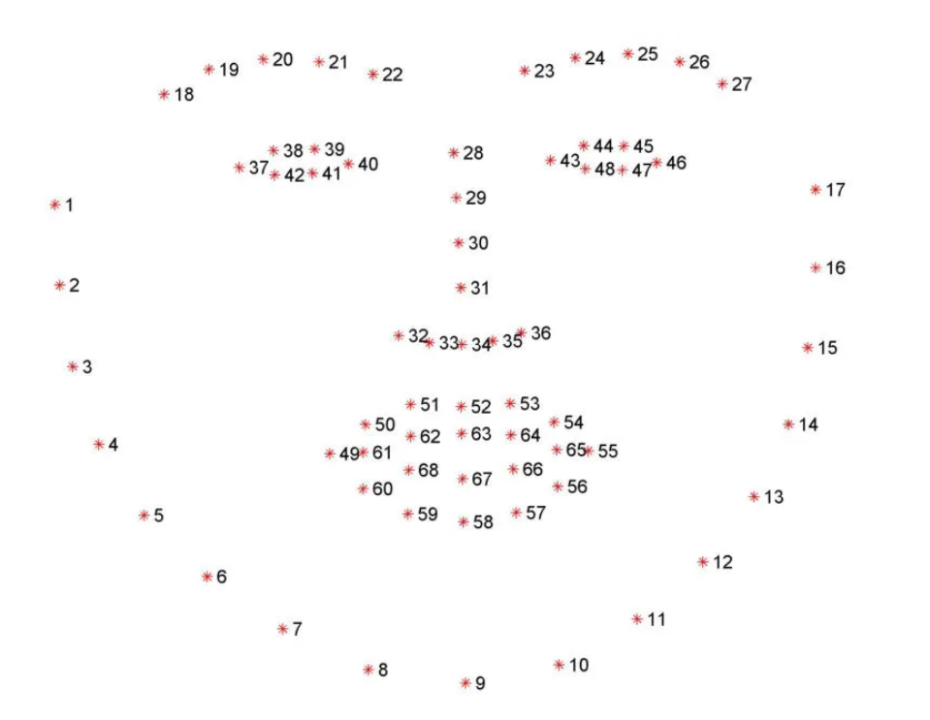
How Face Detection and recognition works
This system uses dlib face recognition library :
It‘s a landmark’s facial detector with pre-trained models, the dlib is used to estimate the location of 68 coordinates (x, y) that map the facial points on a person’s face like image below. This is why one image is also enough for face detection.

Slide 16
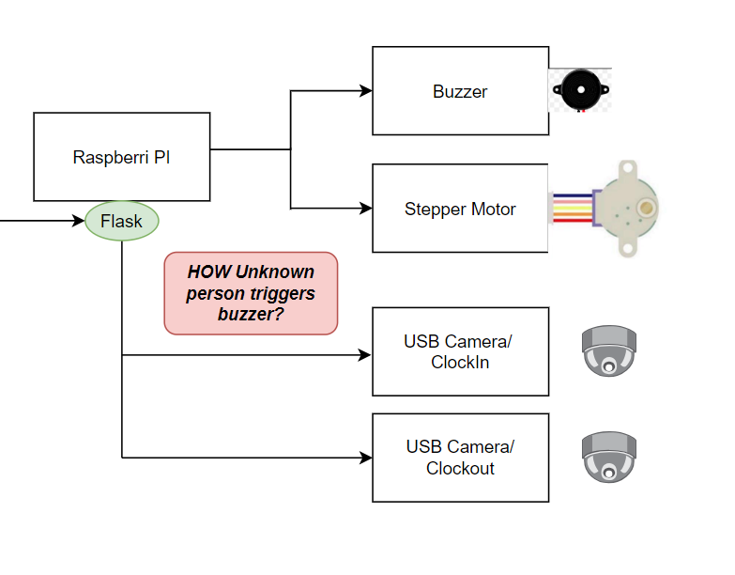
How the speaker, buzzer and motor is controlled using Django and Nextjs.
Django facilitates REST API calls to a Flask application, which is running on a Raspberry Pi to control the speaker, buzzer, and motor. This setup enables remote execution, allowing actions to be triggered on the Flask app, thereby controlling various sensors. With this configuration, we can efficiently manage and execute commands to interact with the hardware components, providing seamless control over the speaker, buzzer, and motor through Django and Next.js integration.

Slide 17
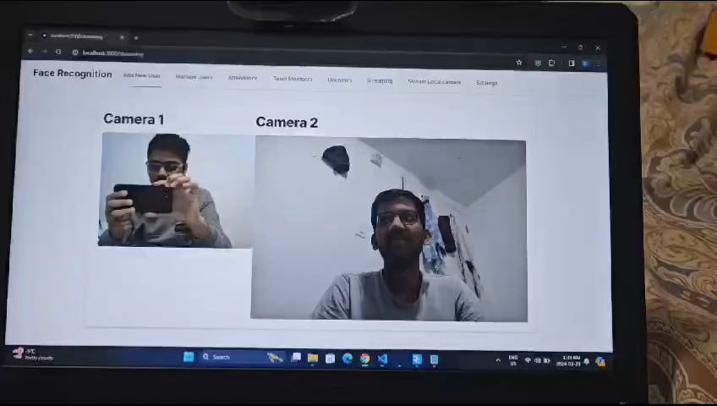
Results
Demo Video

Slide 18
Limitations/ Challenges
Physical Presence Verification : The attendance system records individuals' attendance upon showing their photo without physically verifying their presence.
Future Work
Physical Presence Verification : Using depth-sensing cameras or similar technologies helps estimate the distance of the detected face from the camera, aiding in verifying physical presence.

Slide 19

Thank you

